Slide 1
Hardware
Presented by : Sneha Sadhu
Course : Cyber Security

Slide 2
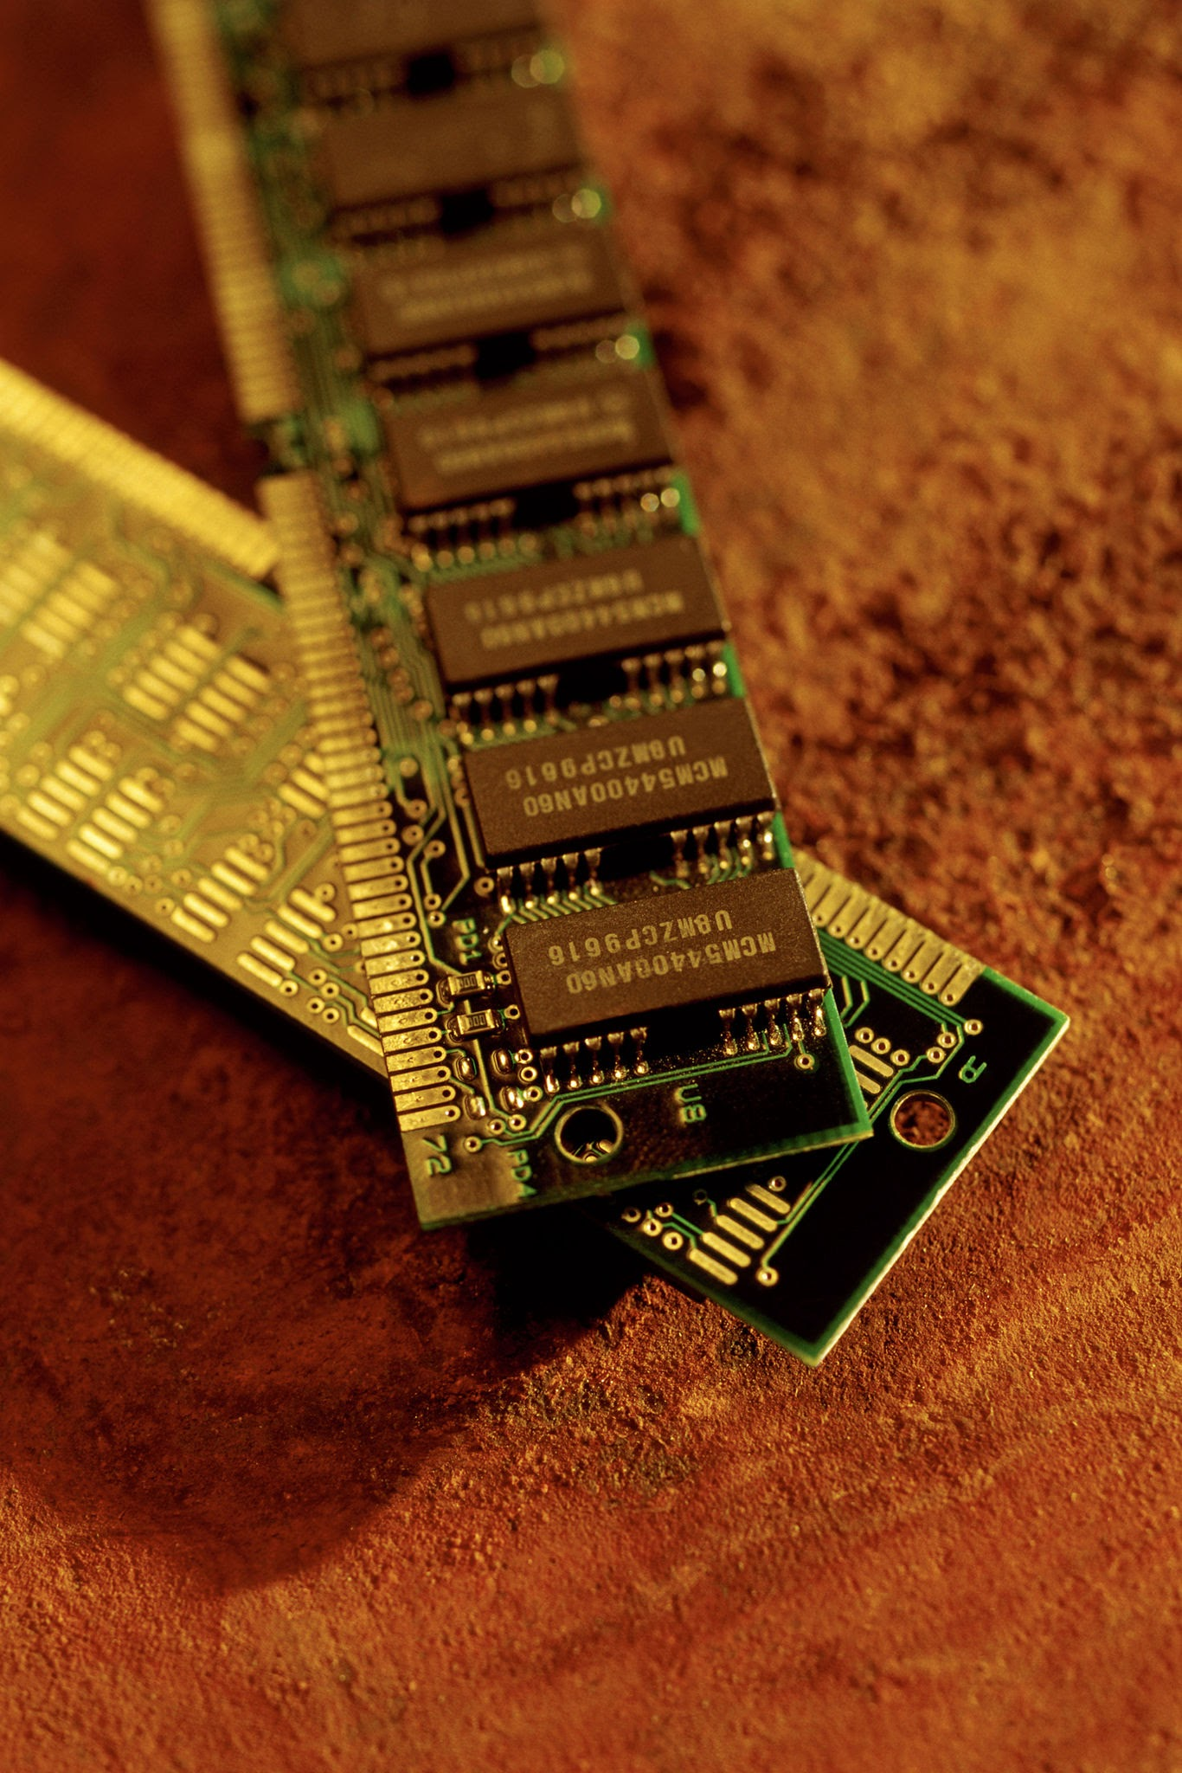
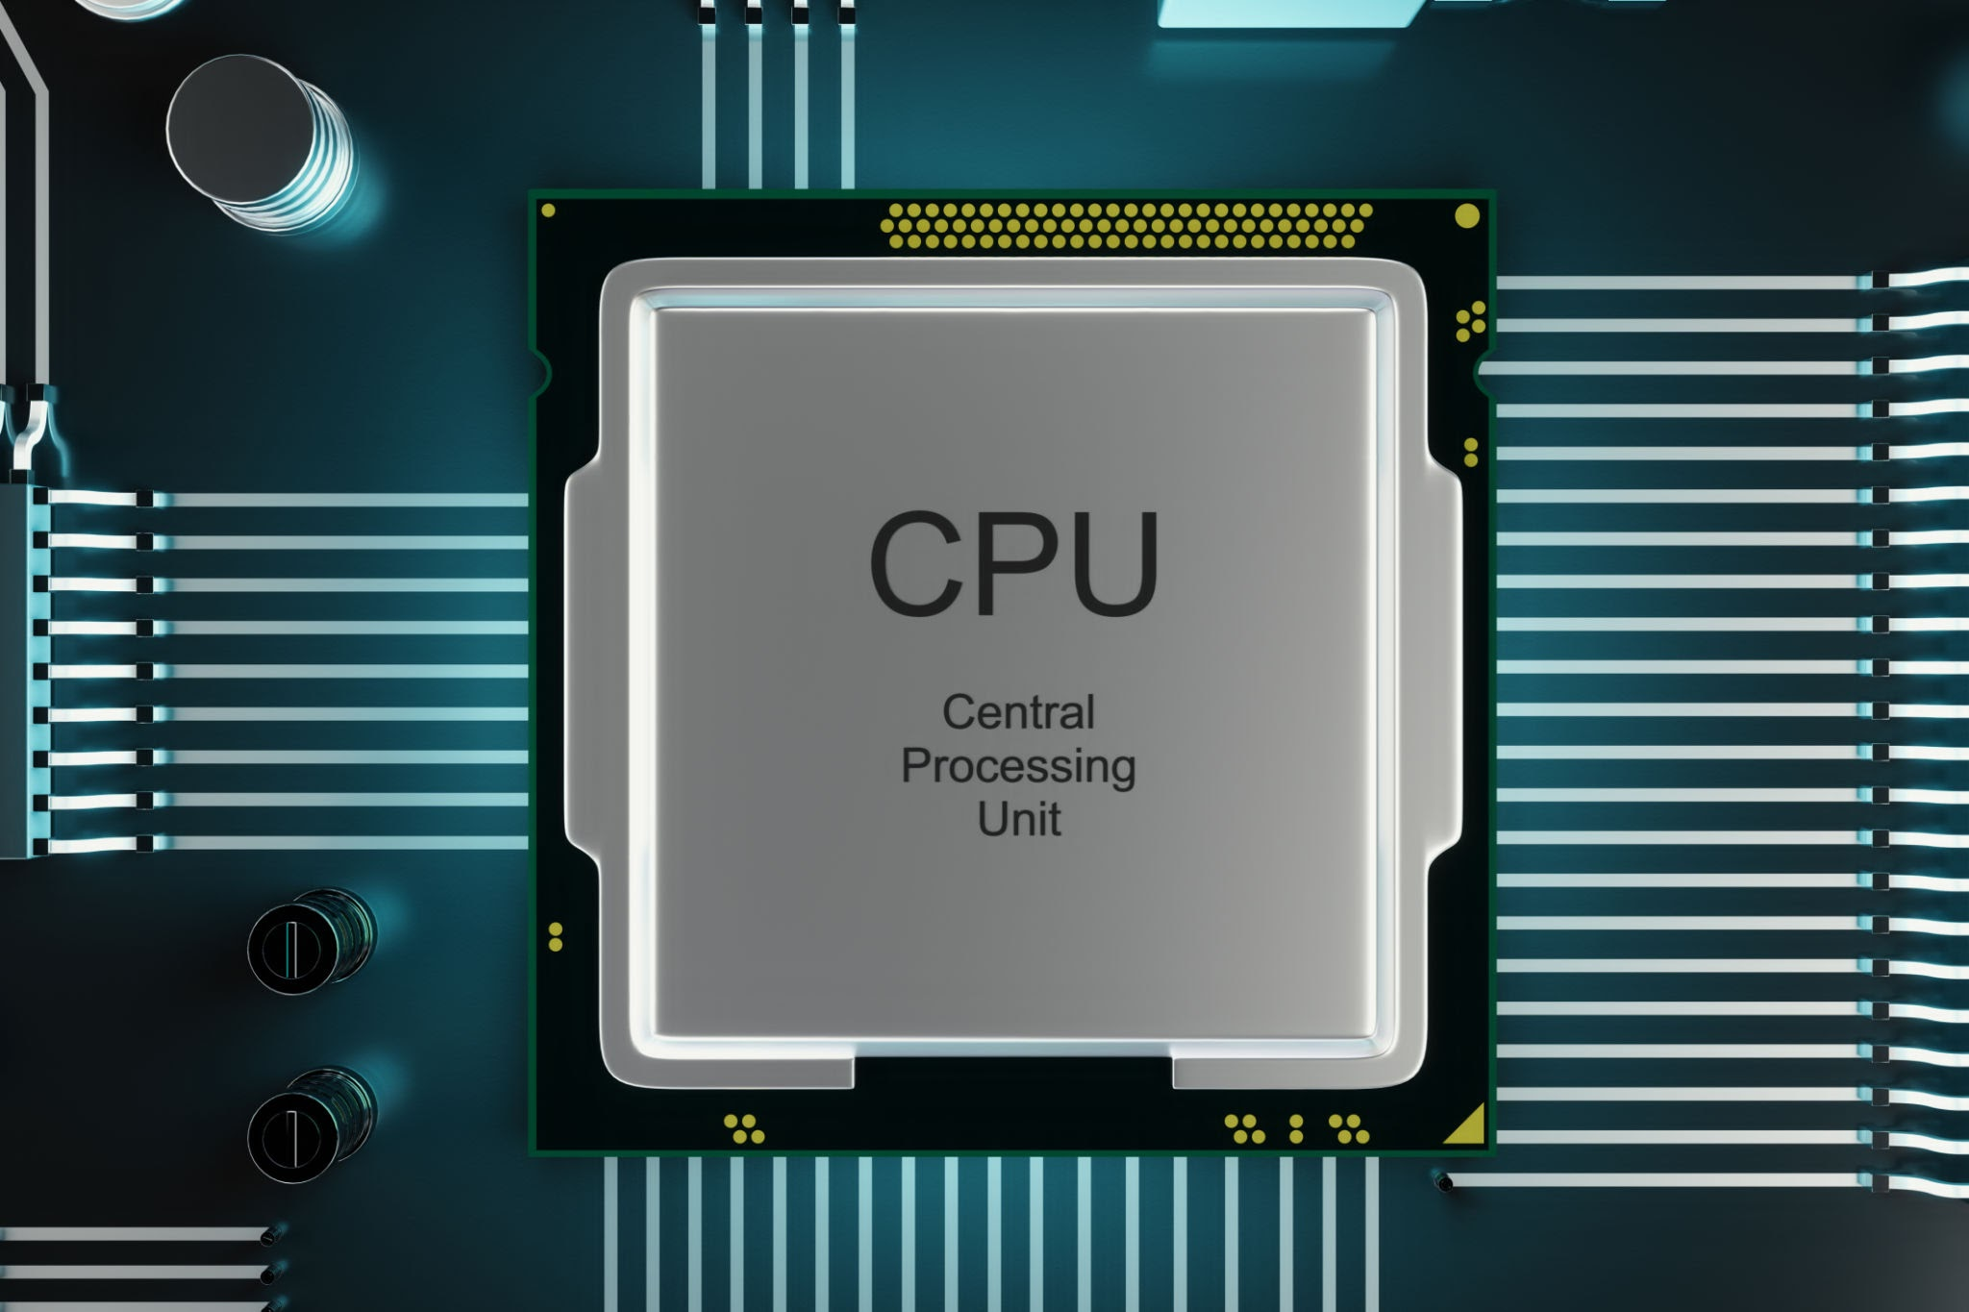
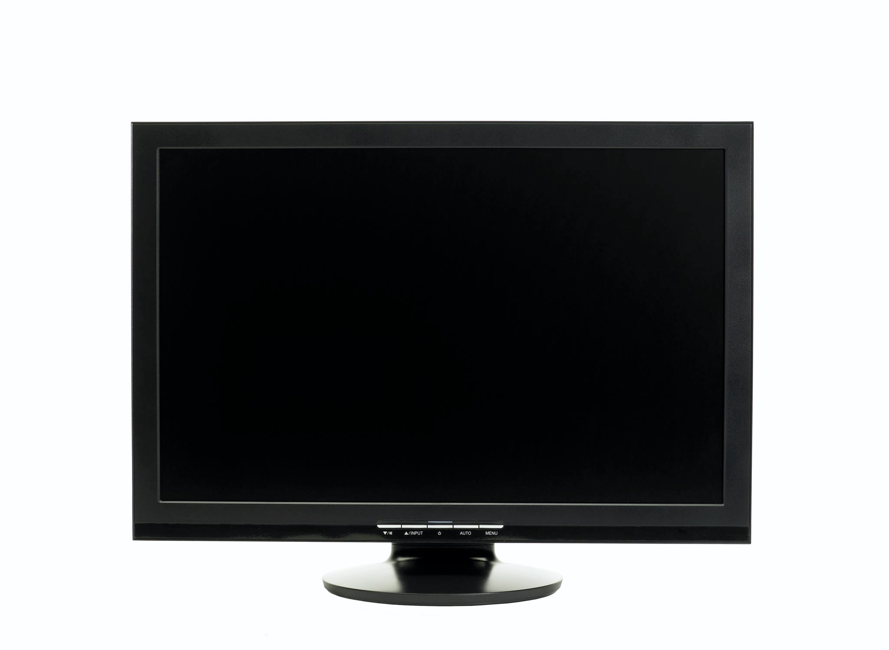
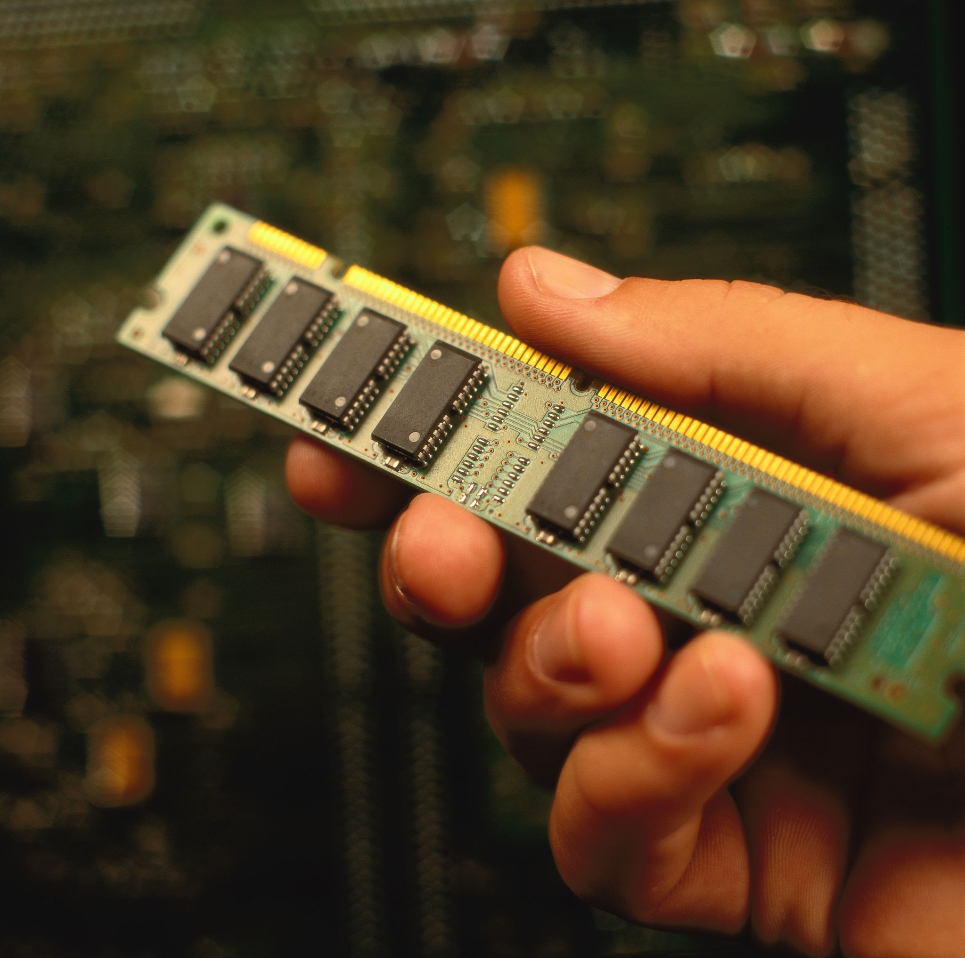
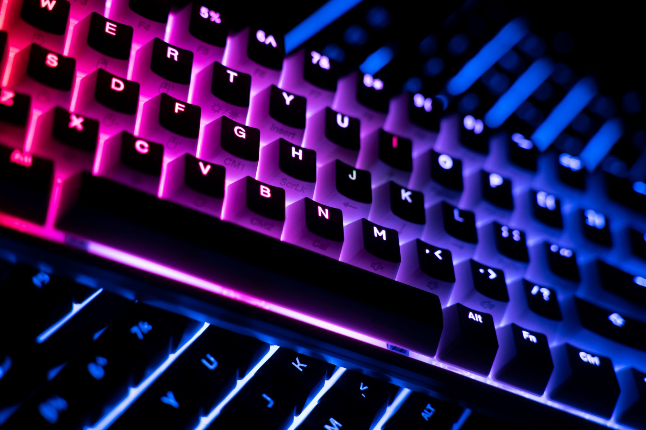
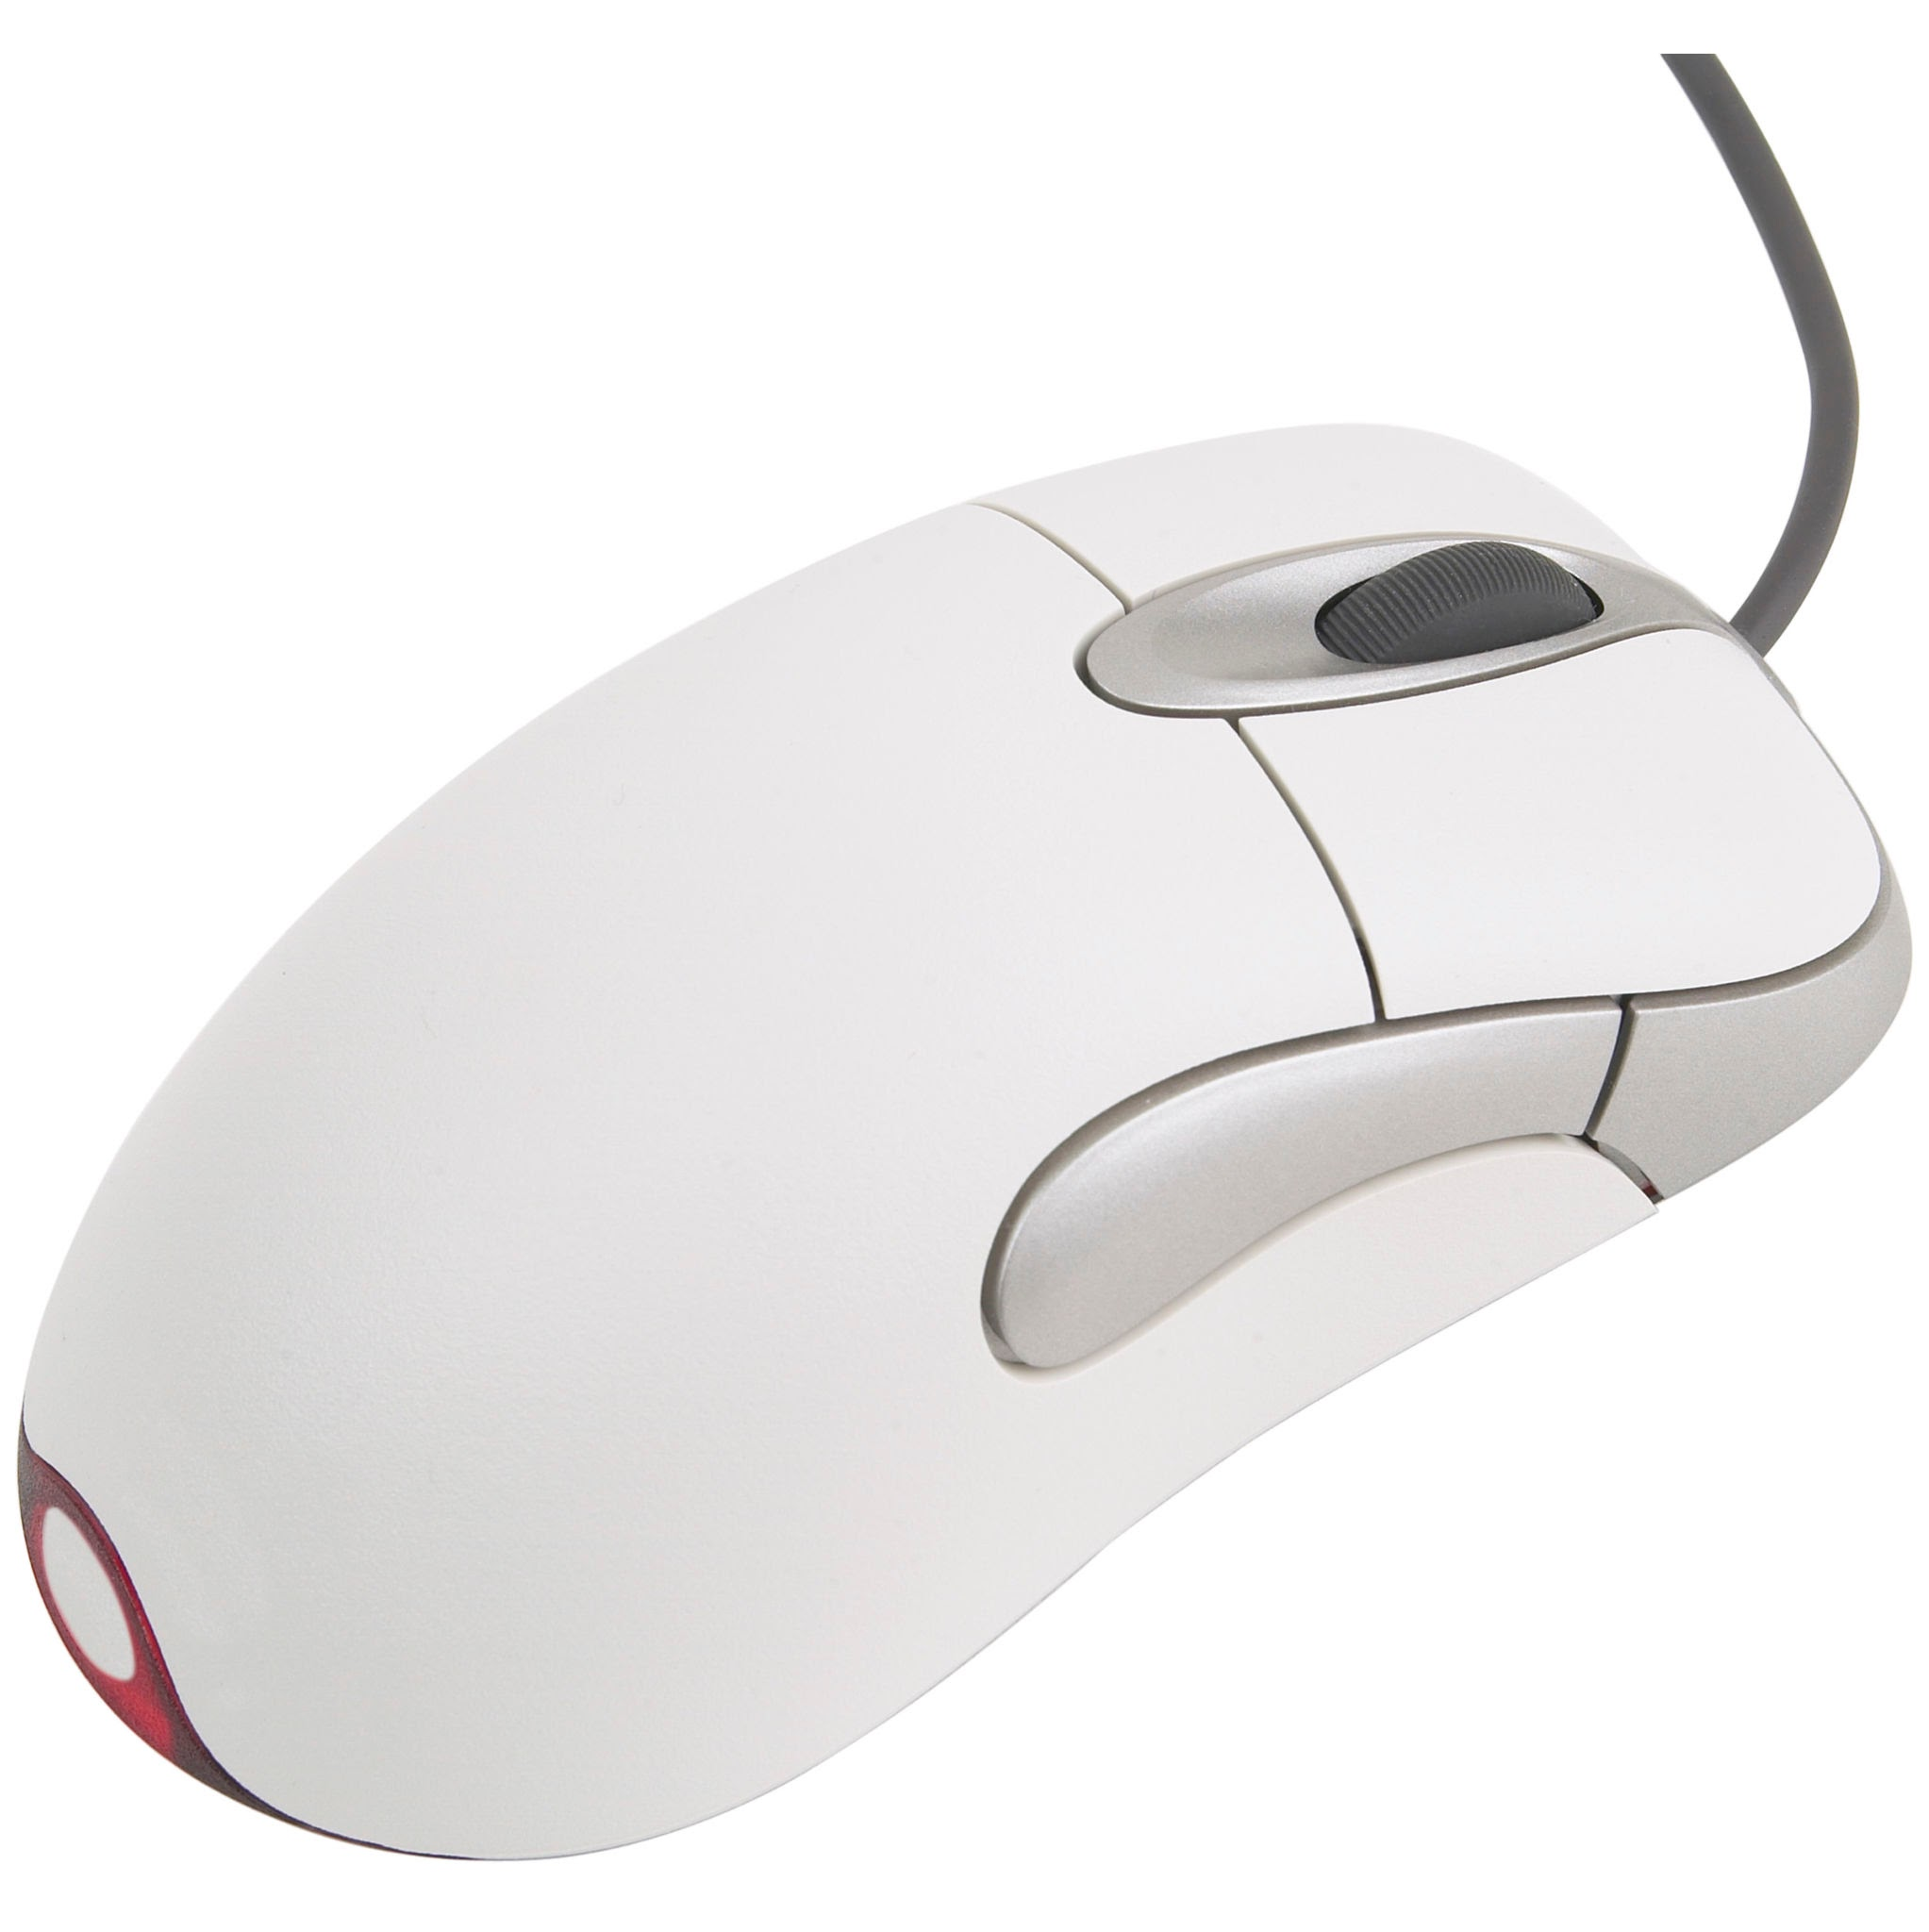
What is Hardware ?
Hardware means the physical parts of a computer.
We can see and touch hardware.
Examples : CPU , RAM , Keyboard , Mouse and Monitor.,

Slide 3
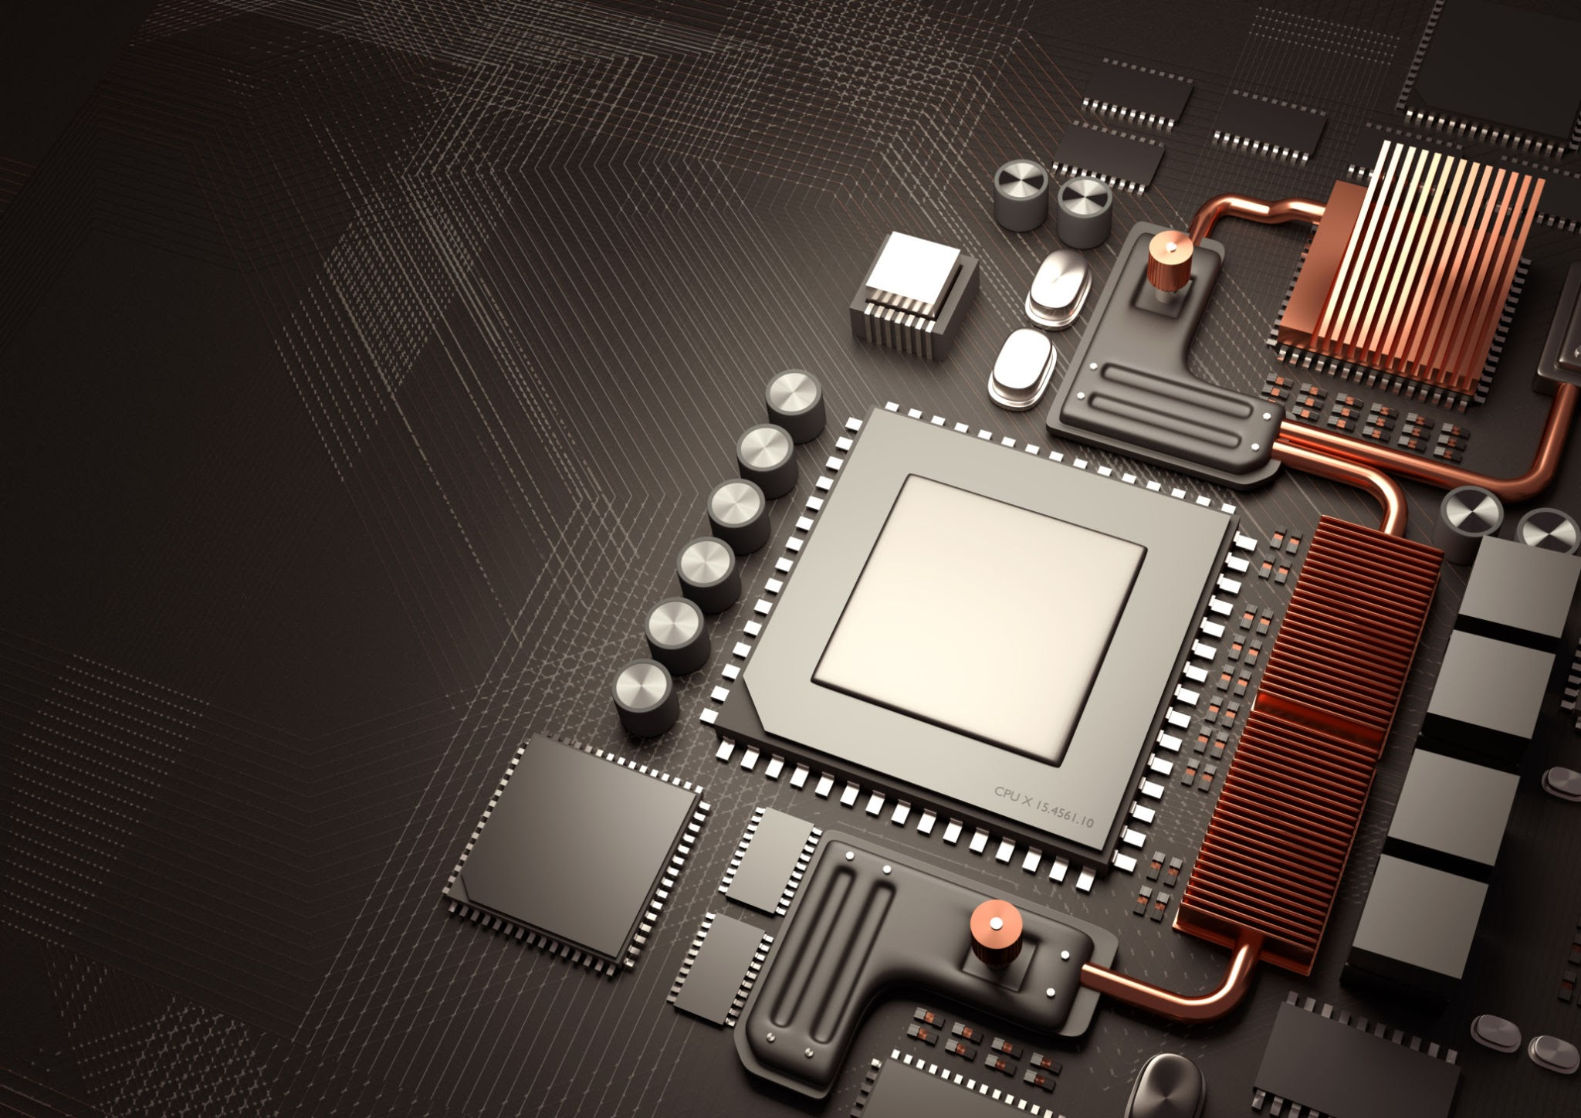
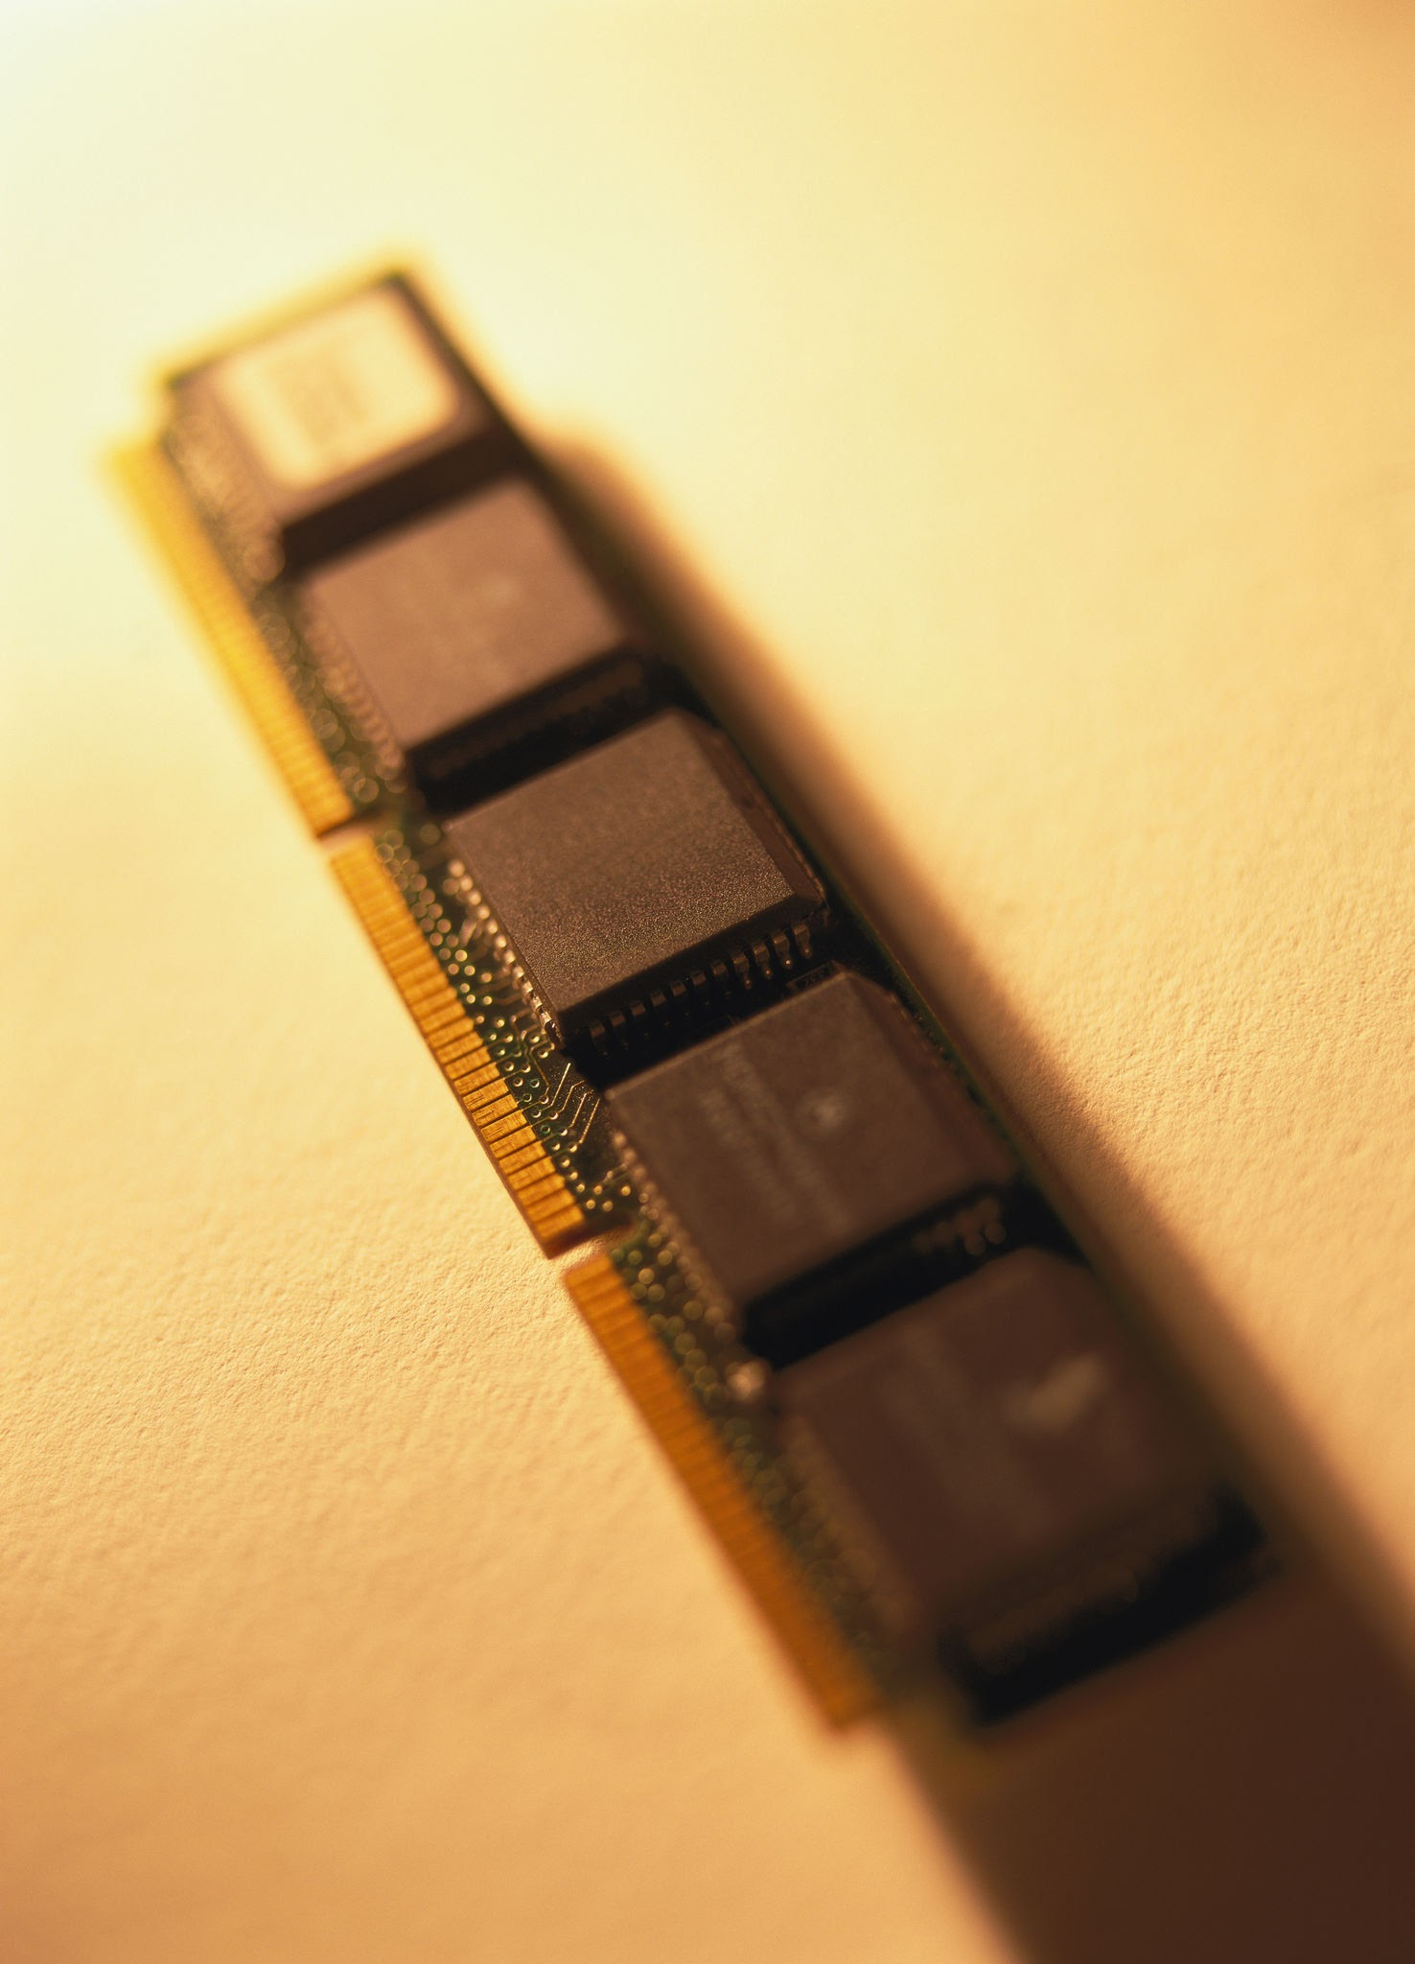
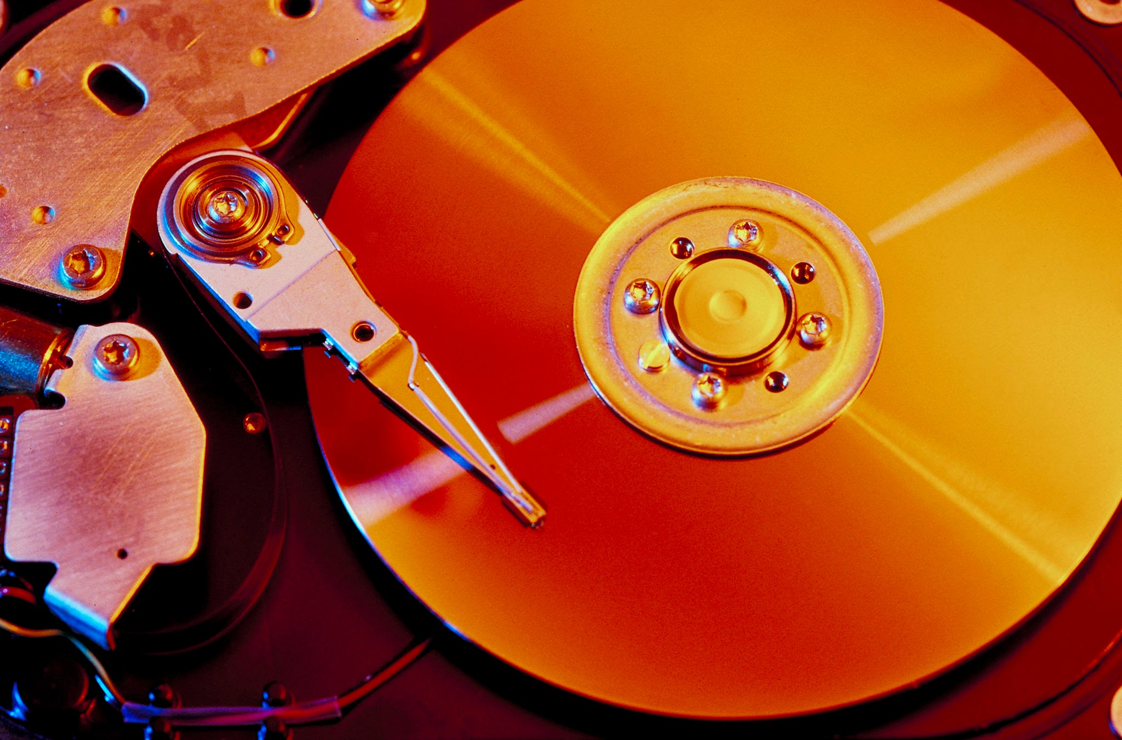
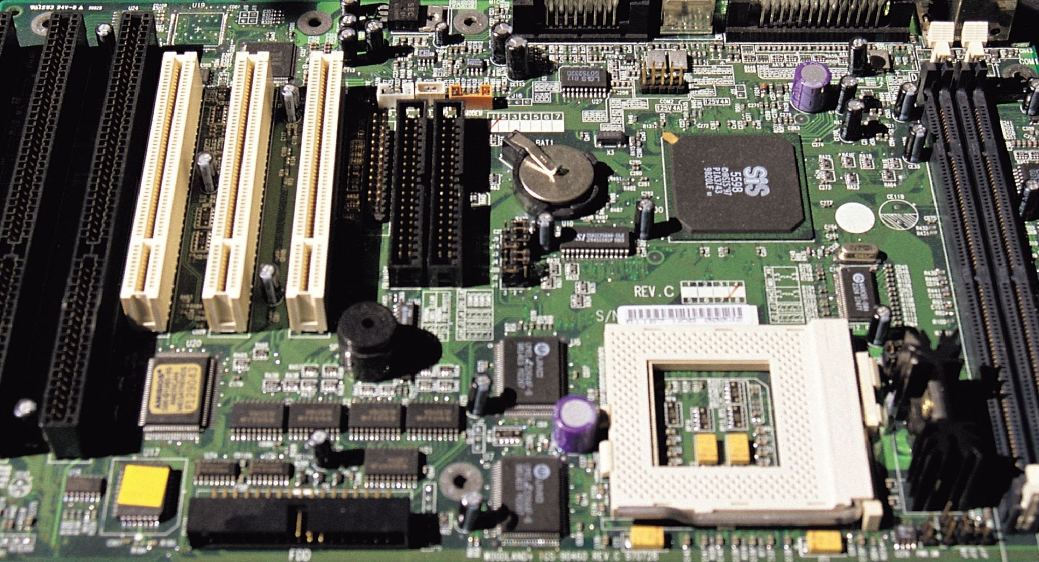
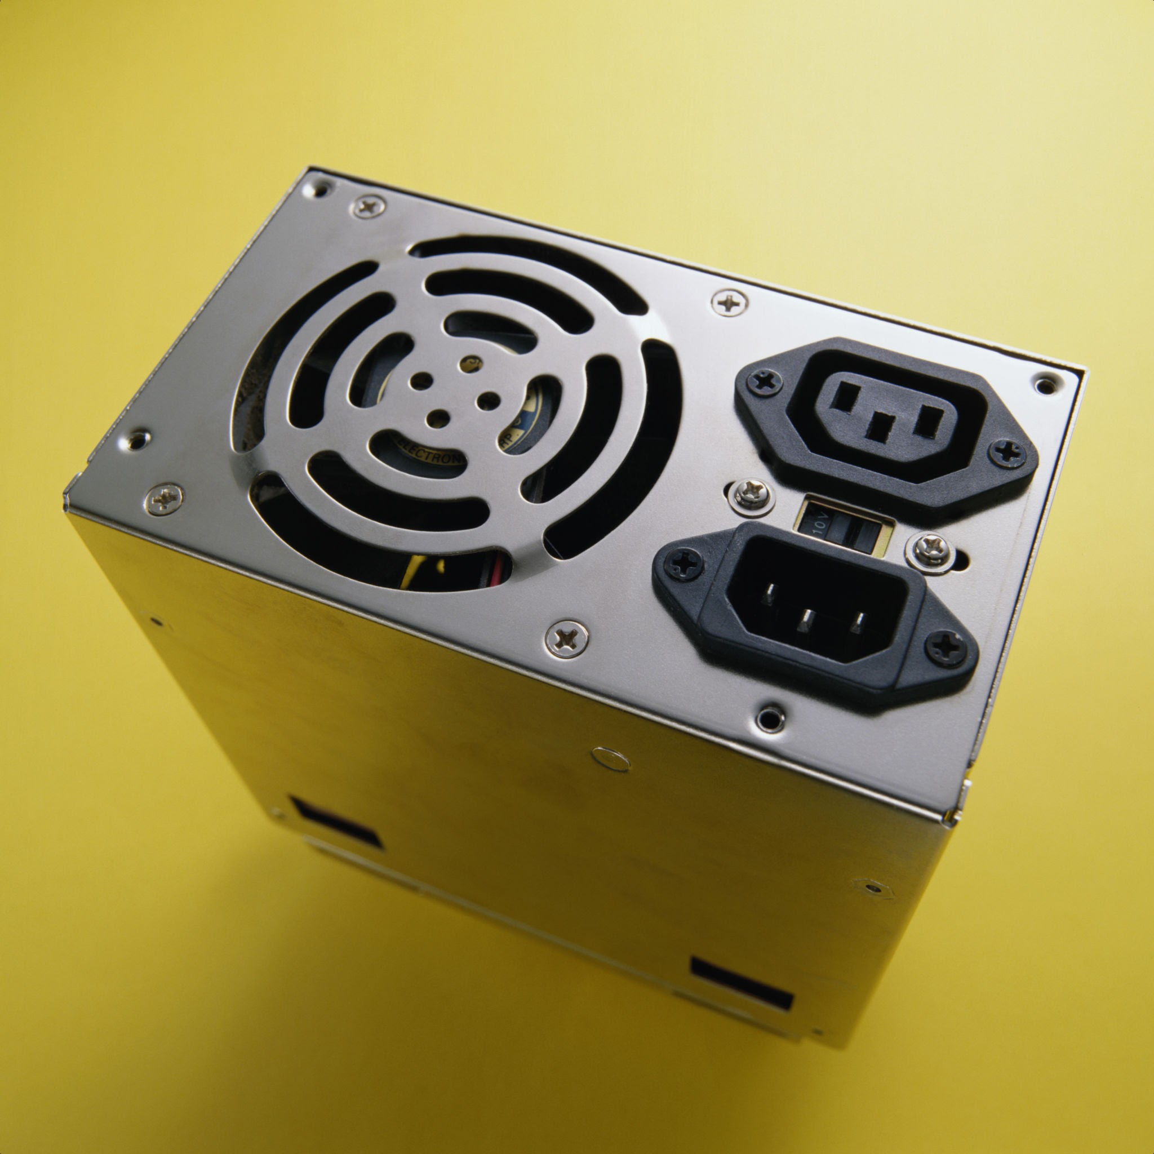
Main Hardware Components
CPU - Processes data .
RAM - Stores data temporarily .
Storage - Stores data permanently .
Motherboard - Connects all components .
SMPS/PSU - Provides power .

Slide 4
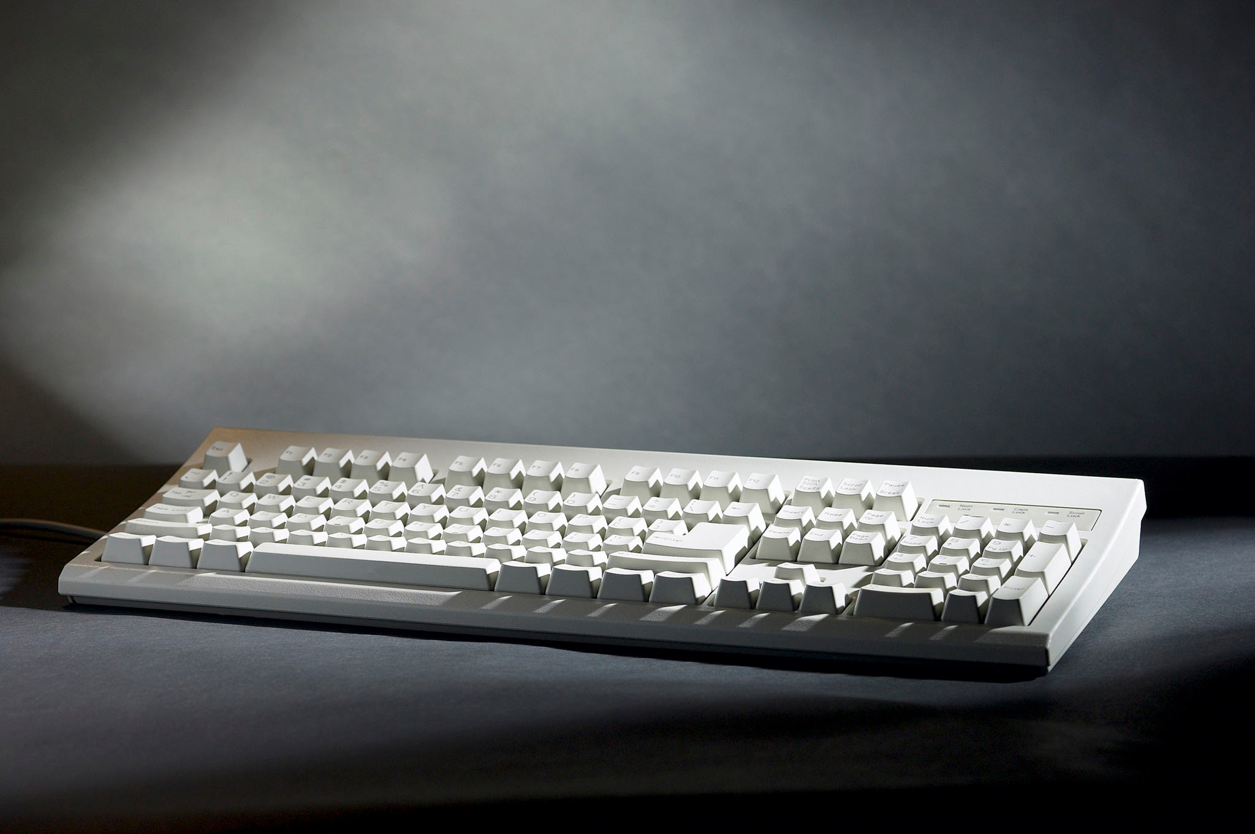
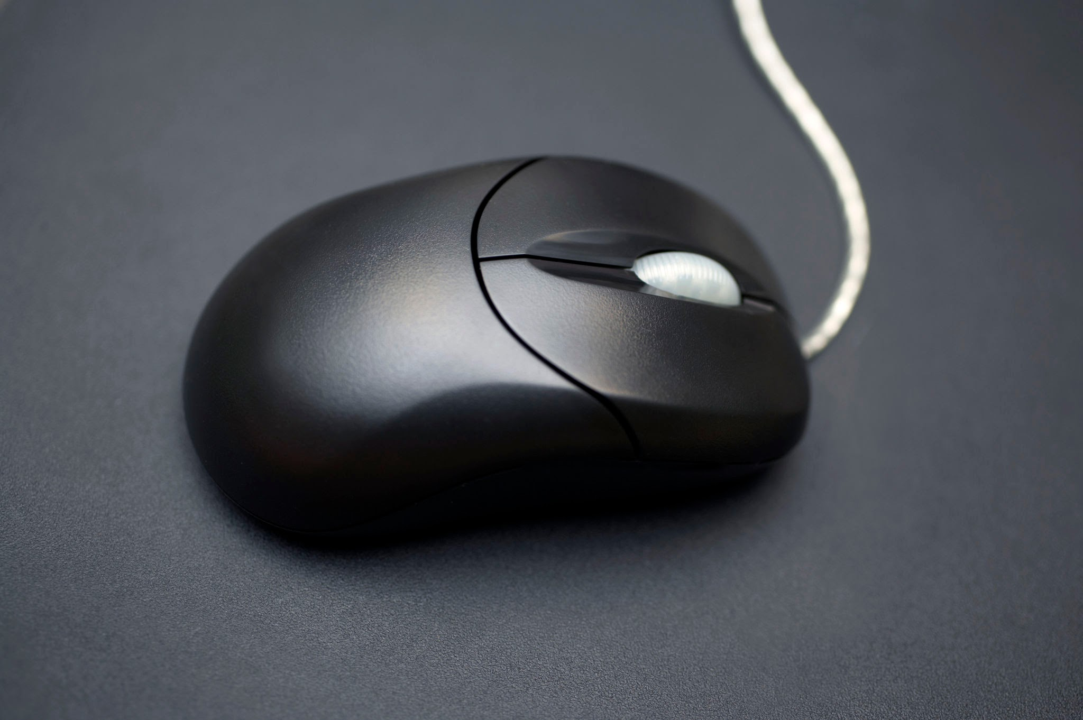
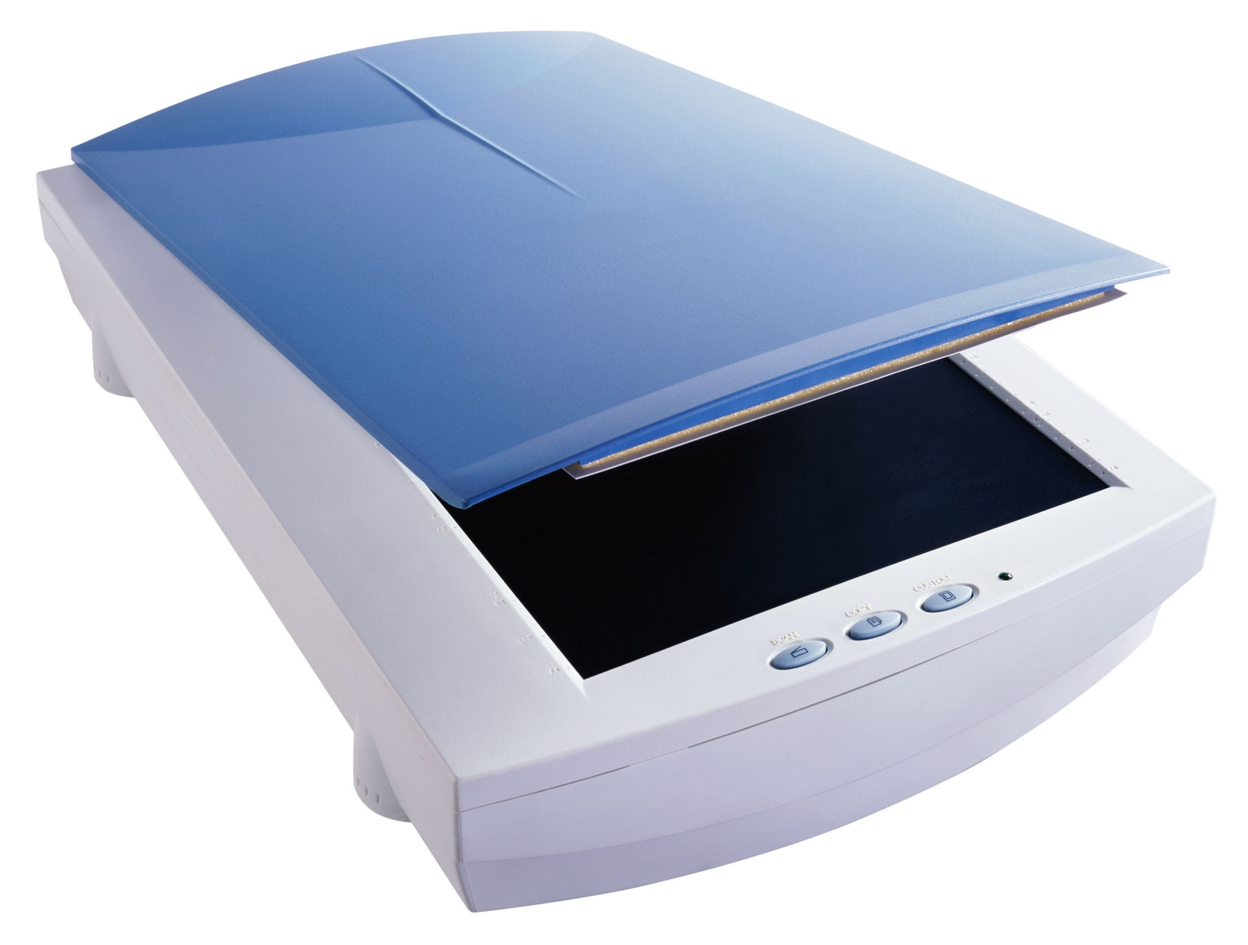

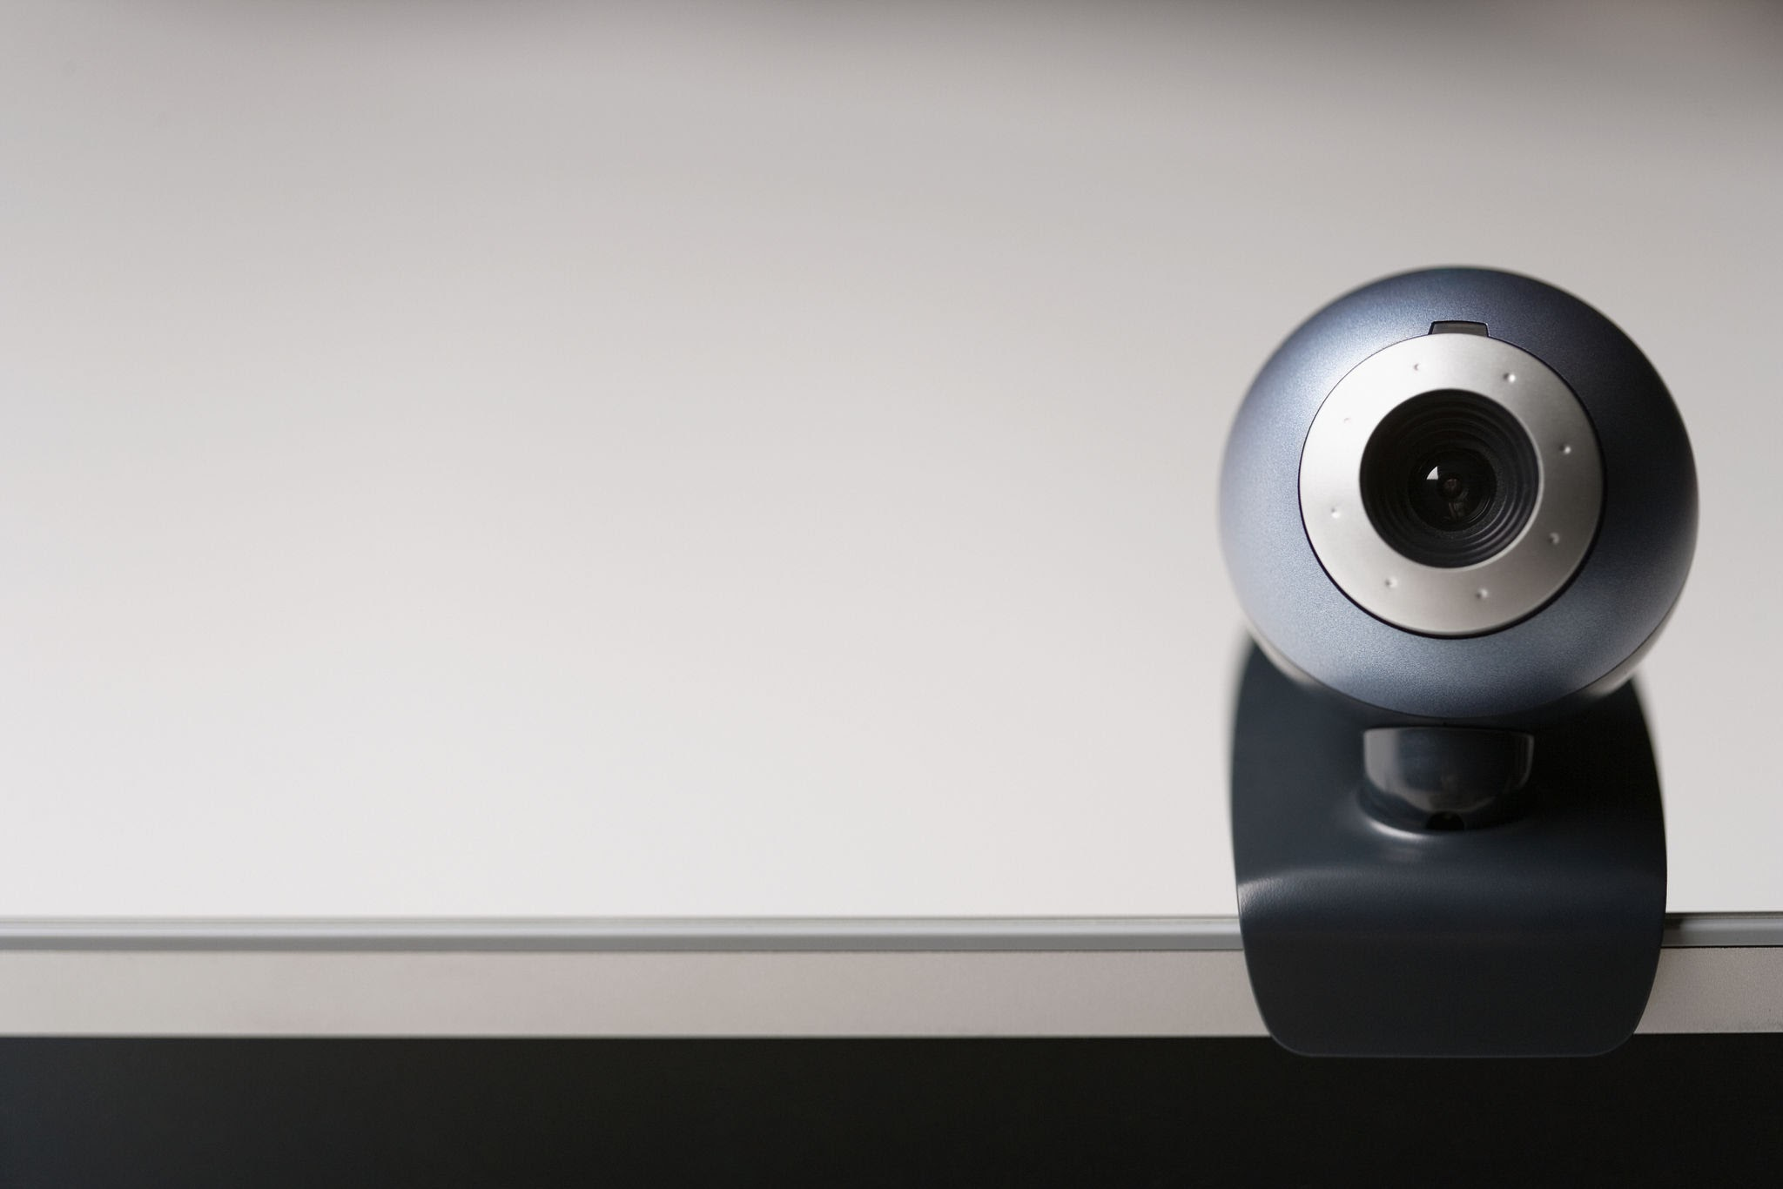
Input Devices
Input devices are used to give data to the computer .
Keyboard
Mouse
Scanner
Microphone
Webcam

Slide 5
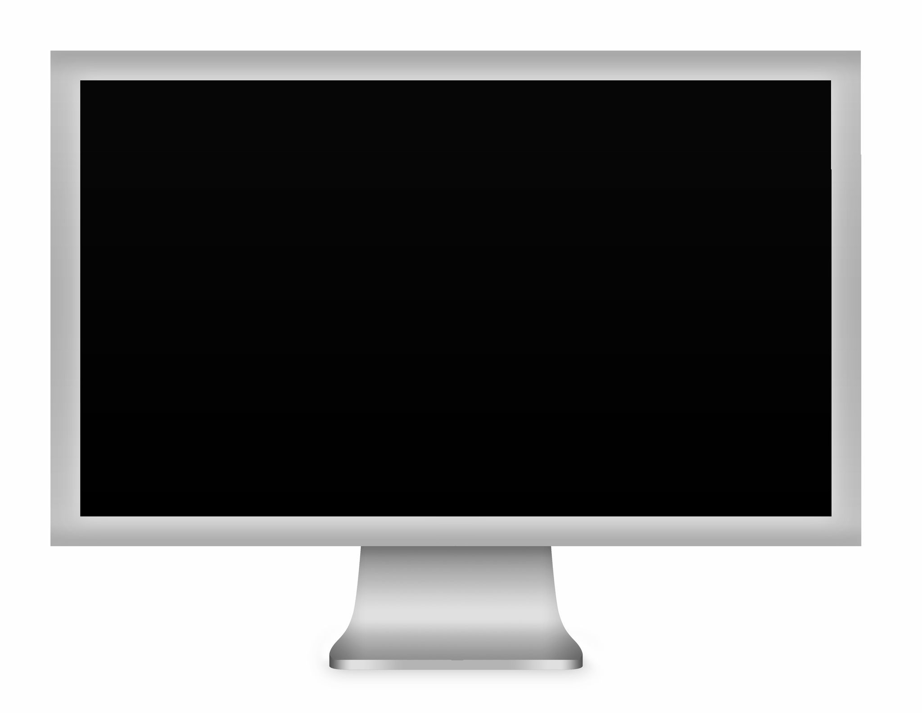
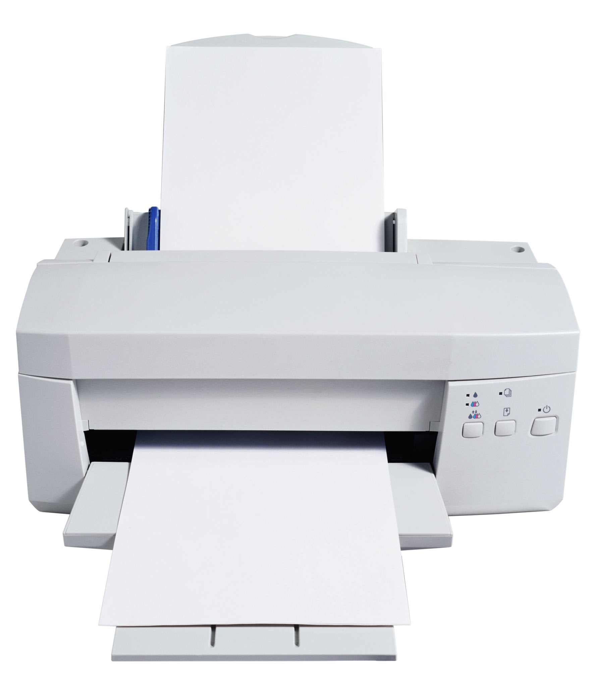
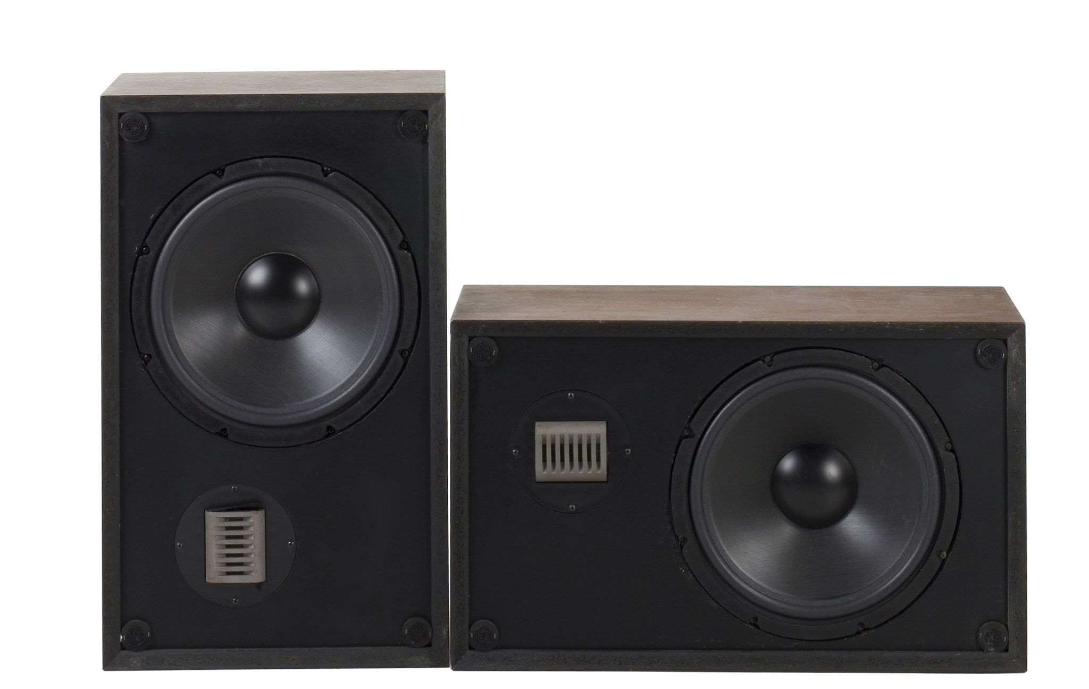
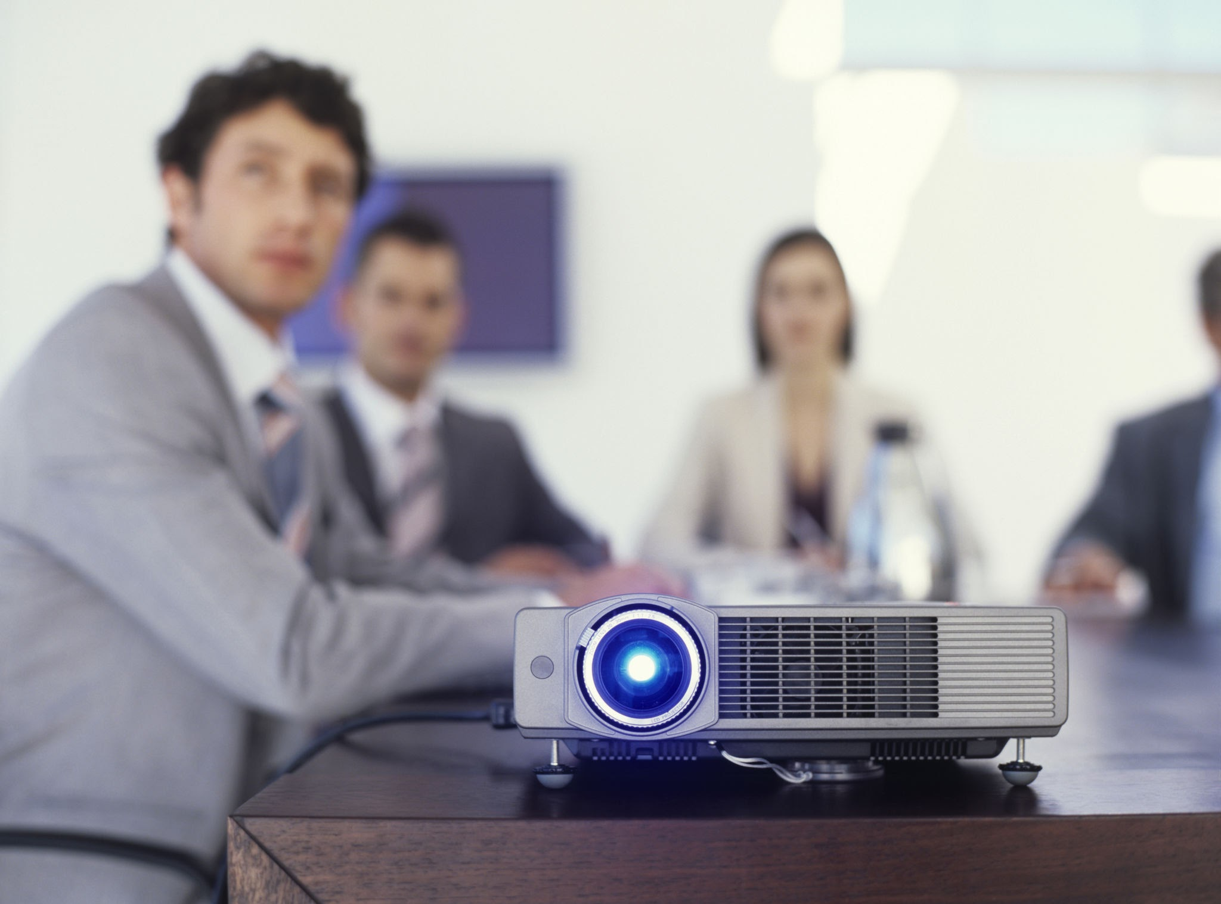
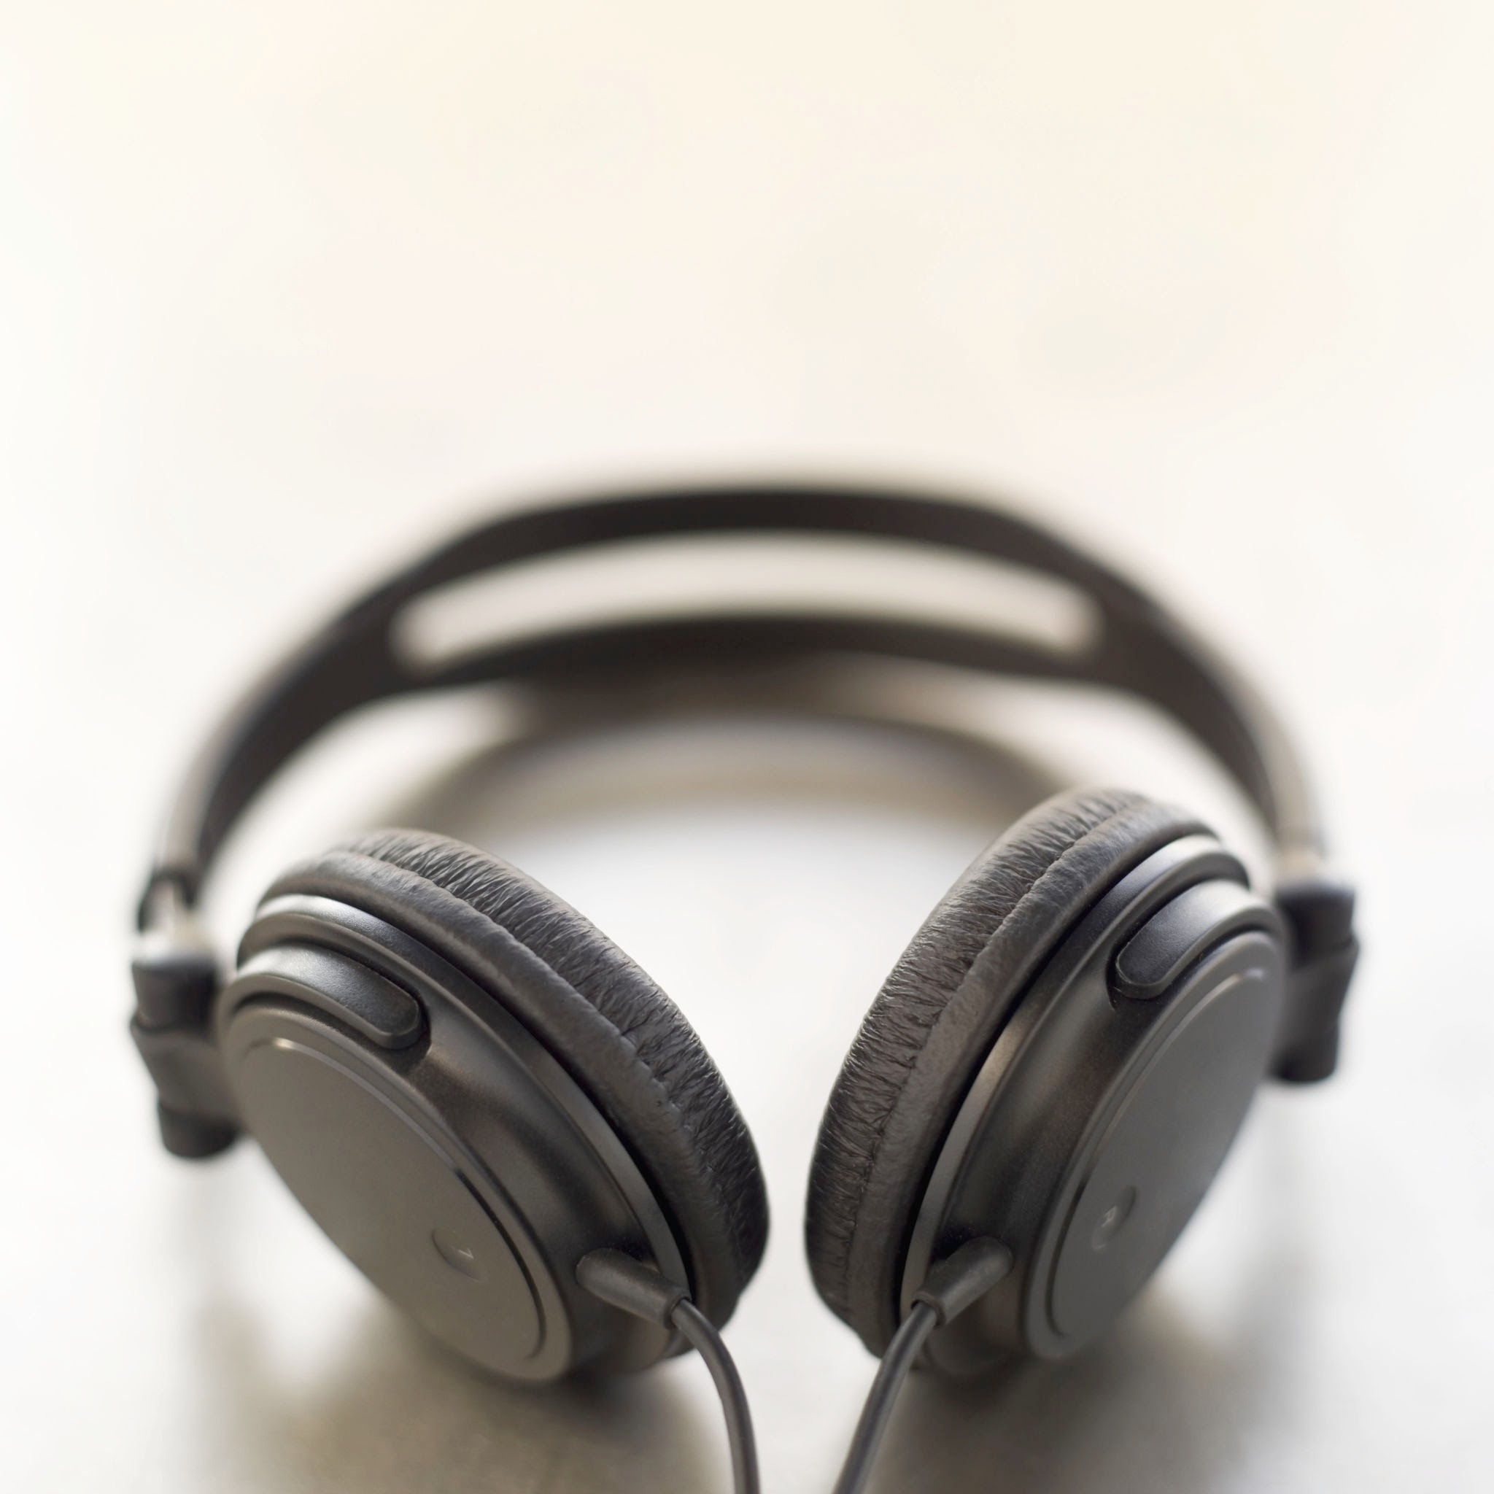
Output Devices
Output devices show the result from the computer .
Monitor
Printer
Speaker
Projector
Headphones

Slide 6
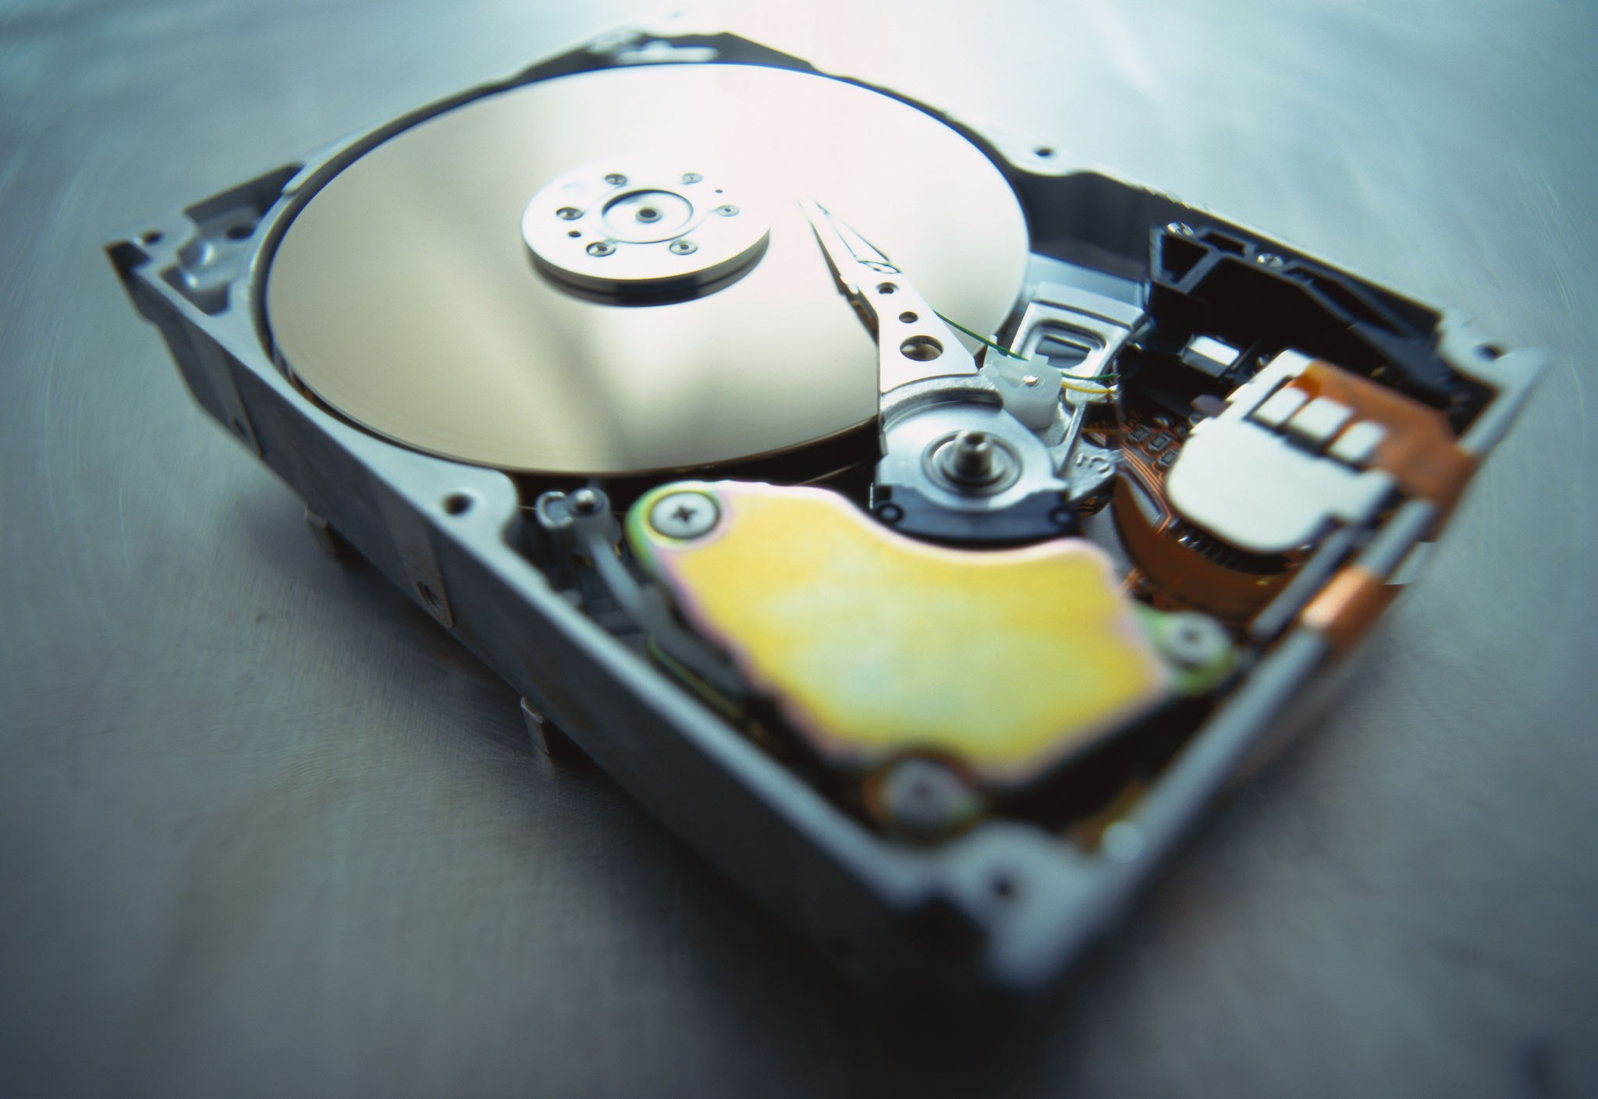
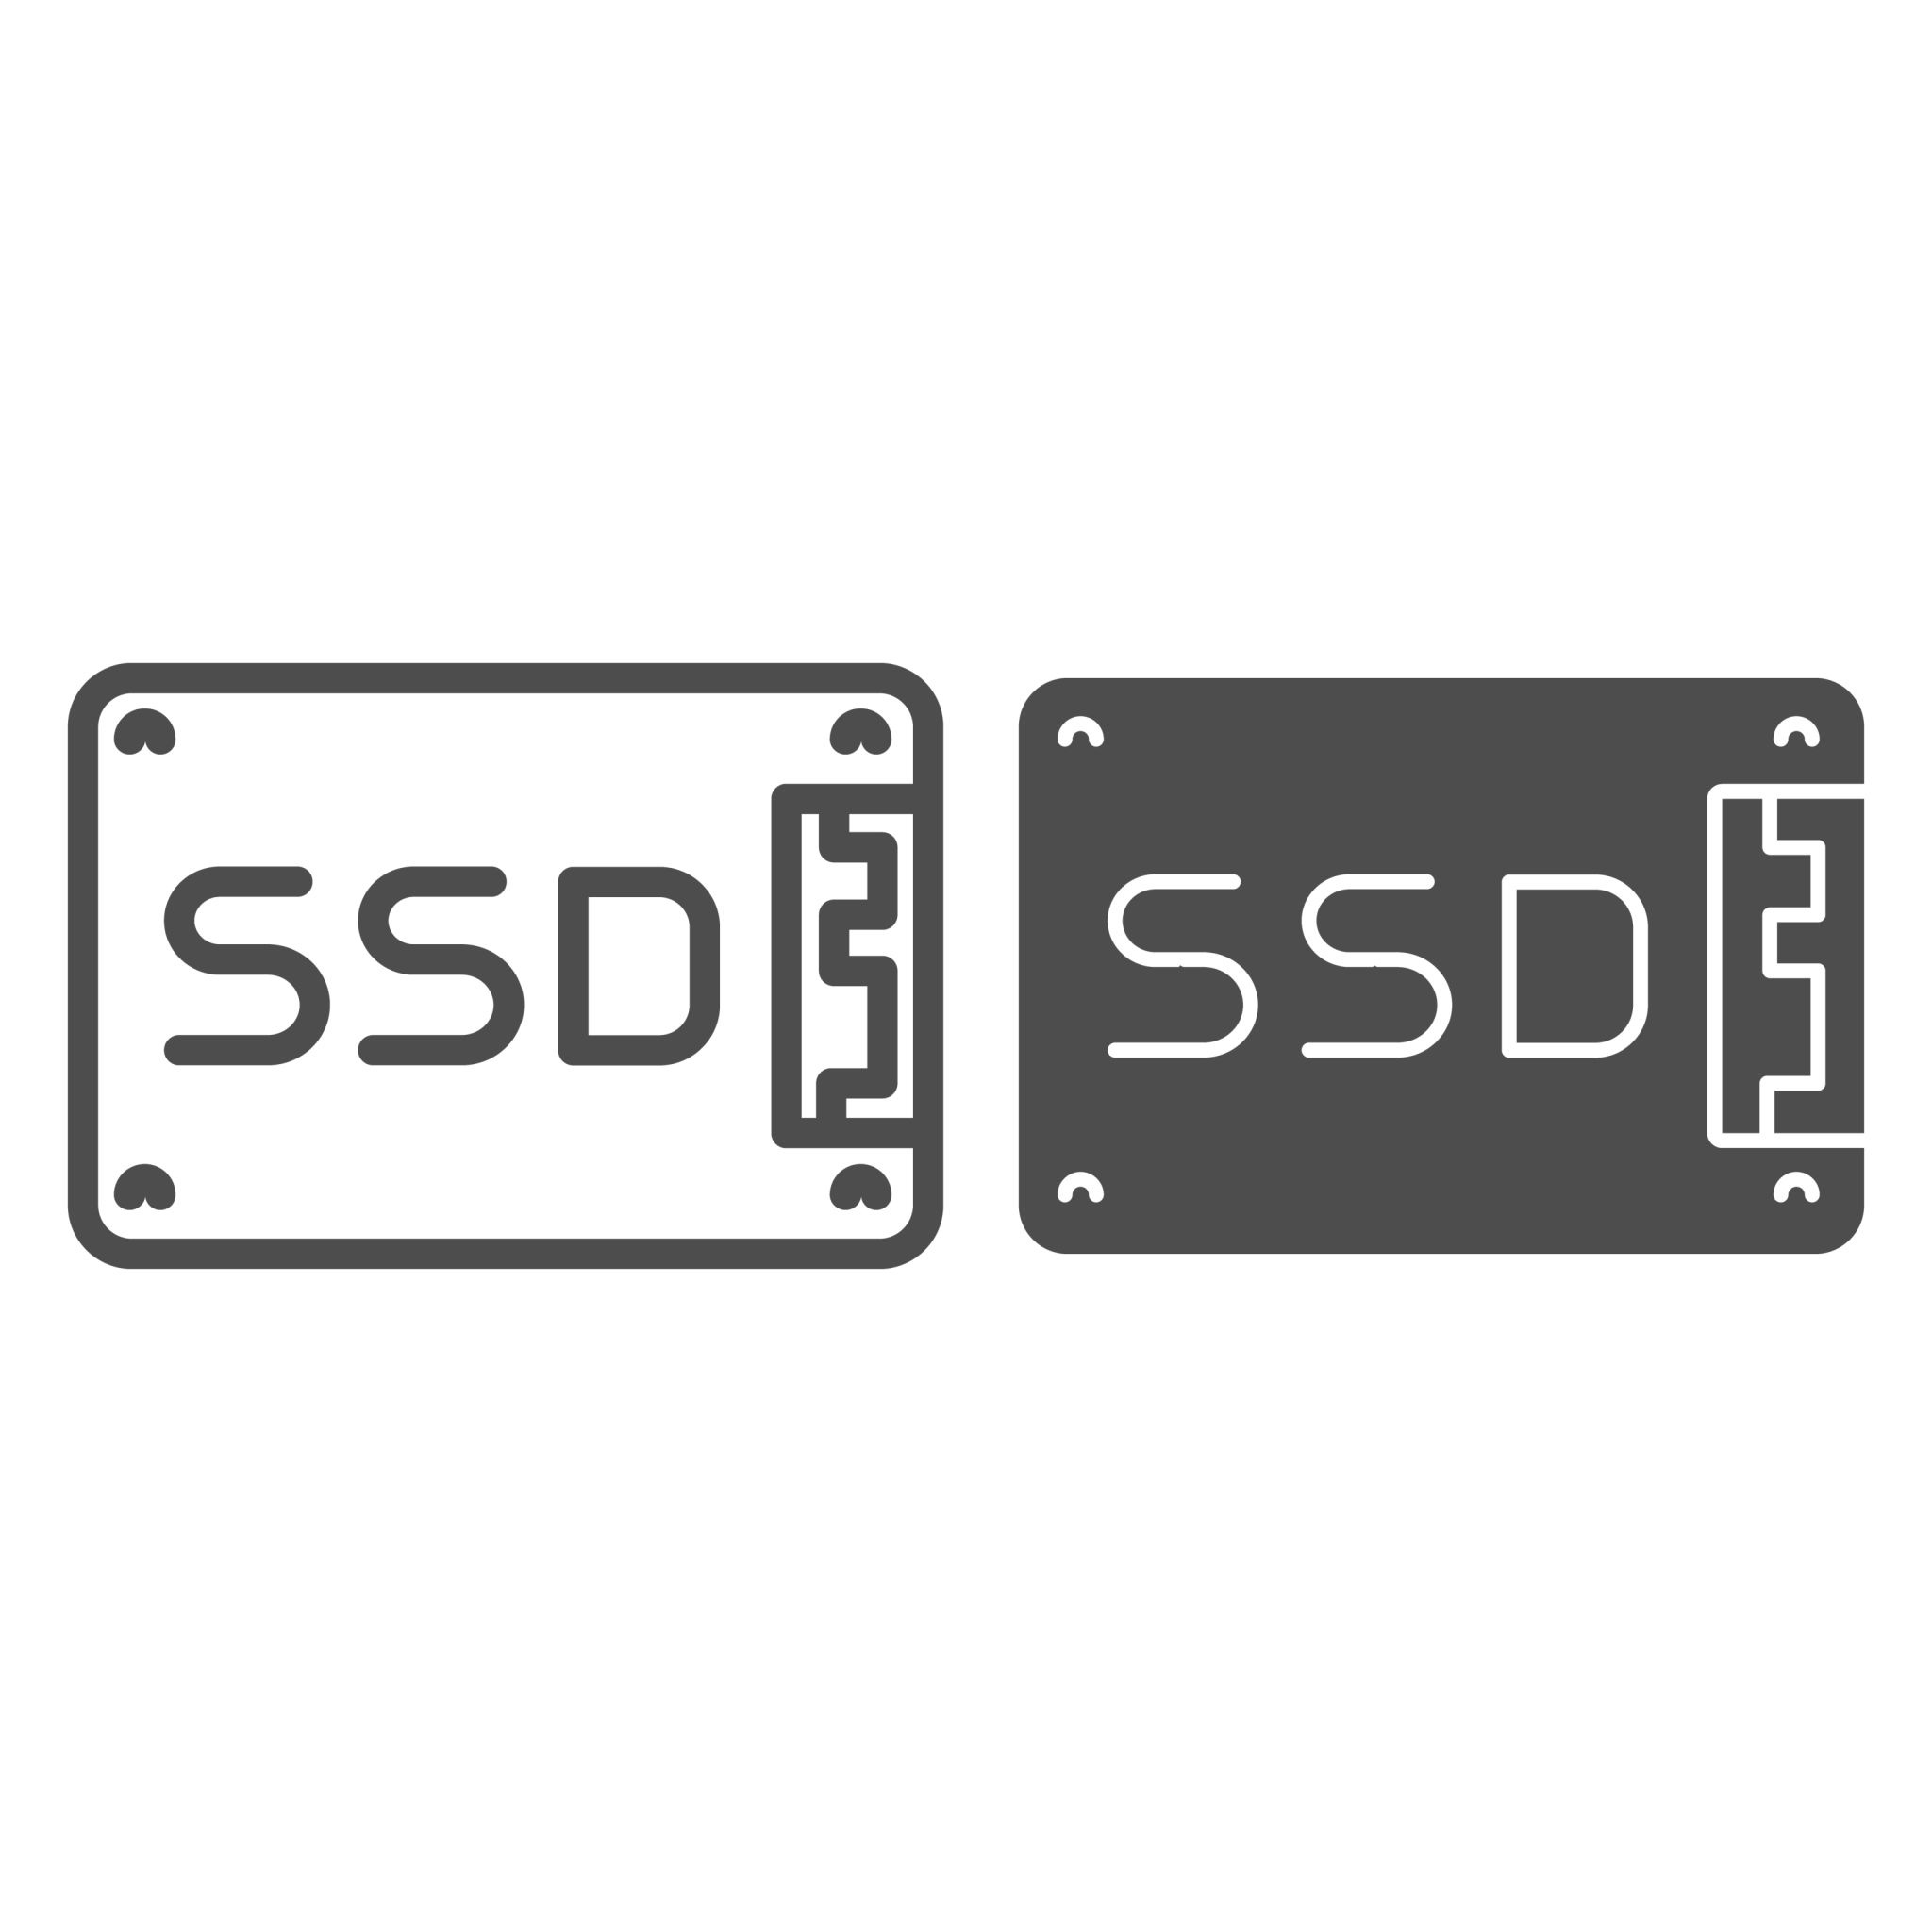
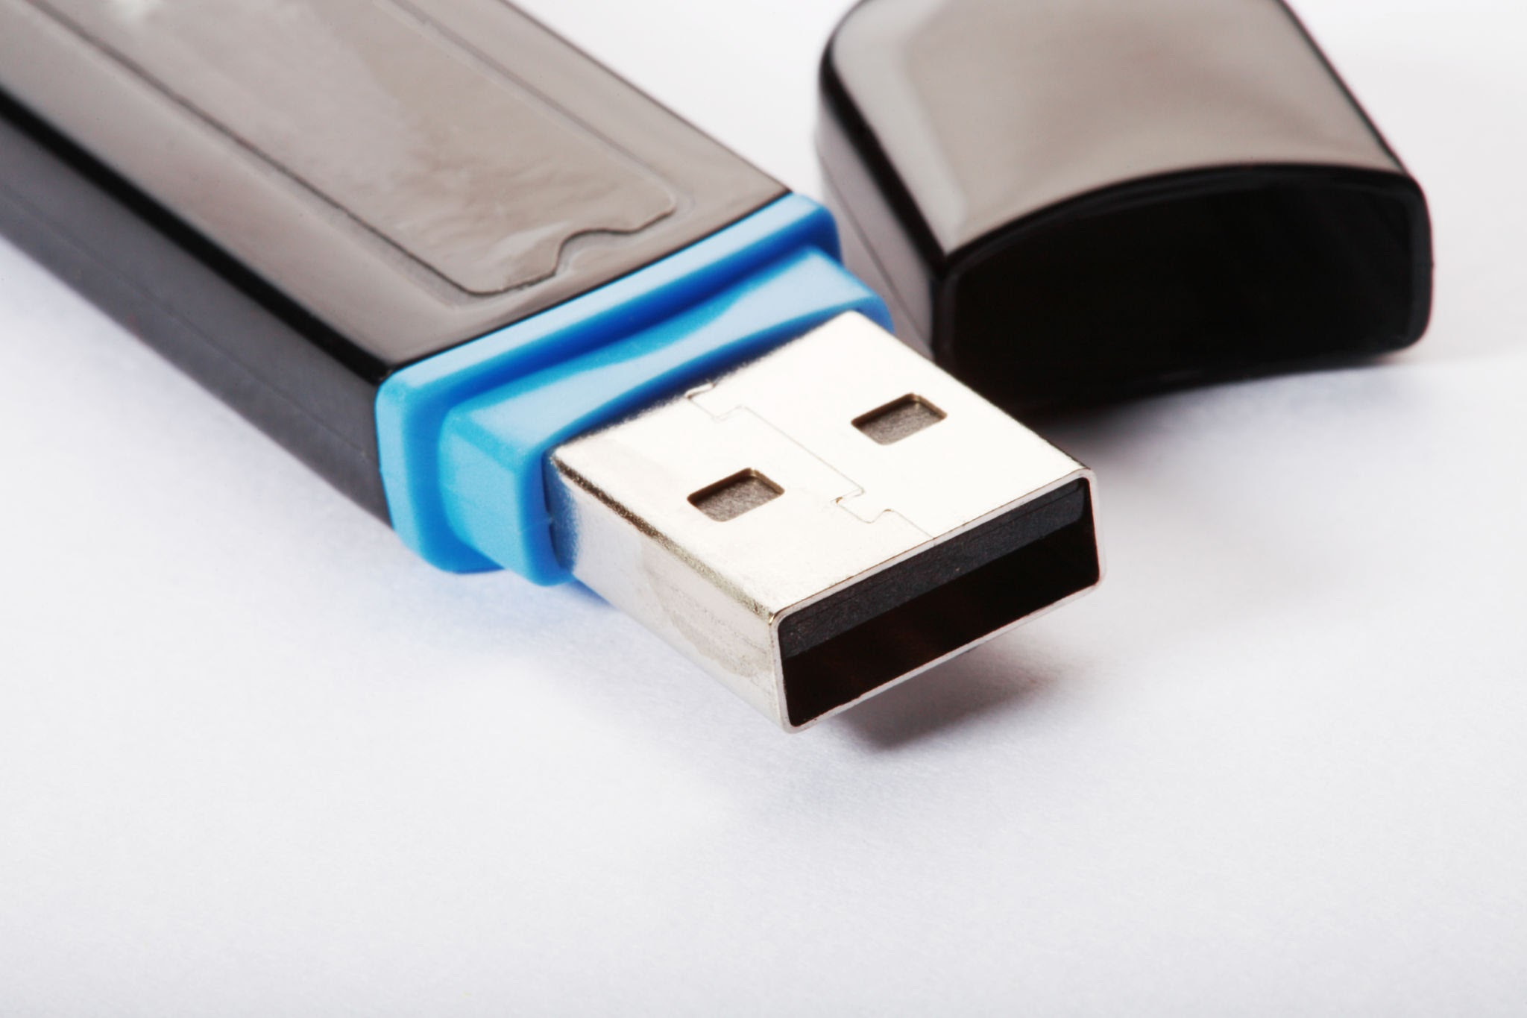

Storage Devices
Storage devices are used to save devices
HDD
SSD
USB Drive
Memory Card

Slide 7
Thank You

